Slide 1

Python for Healthcare Modeling and Data Science
Module 1: Introduction to Data Science and Python

Slide 2
Course Outline

Slide 3


Meet your Instructors

Slide 4
Class Agenda
Introduction
What is programming?
Overview of Python
Installing Python and setting up the environment
Running your first python program

Slide 5

What is Programming?

Slide 6

What is coding/Programming?
Computers are built for one purpose - to do things for us
You can think of a computer as a servant who is always waiting for your next command
To give your commands to a computer, you need to communicate with it.
However, a computer only communicates in binary – 1s and 0s
As an example, the binary for "Welcome to python" looks like
01010111 01100101 01101100 01100011 01101111 01101101 01100101 00100000 01110100 01101111 00100000 01110000 01111001 01110100 01101000 01101111 01101110

Slide 7

Programming language
It would be unrealistic to communicate using binary
This is where a programming language comes in
One of the key functions of a programming language is to convert natural language instructions into binary code that can be executed by a computer. It also does the reverse!
There are tens of thousands of programming languages out there so which one do we choose?
We pick PYTHON!
This Photo by Unknown Author is licensed under CC BY-SA

Slide 8

Overview of Python

Slide 9
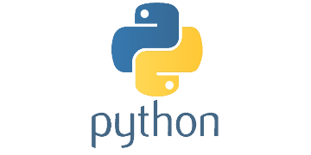
What is Python?
Python is a high-level, interpreted programming language created by Guido van Rossum and first released in 1991. It is known for its readability, simplicity, and versatility, making it an excellent choice for both beginners and experienced programmers.
Fun Fact: Experts or Enthusiast of Python are called Pythonistas

Slide 10
Brief history of python
Guido van Rossum began developing Python in late 1989 as a successor to the ABC language.
The first official release, Python 1.0, came out in January 1994, featuring exception handling, functions, and various core data types.
Python 2.0 was released in October 2000, introducing list comprehensions and a garbage collection system.
Python 3.0, a significant update with backward-incompatible changes, was released in December 2008. It aimed to fix some of the design flaws in Python 2 and improve the language's consistency.
Since then, Python has continued to evolve with regular updates, and Python 3.x has become the standard version used by most developers.

Slide 11
Advantages of Python
Easy to learn and read: Python has a clear, intuitive syntax that emphasizes readability, making it easier for beginners to learn and understand.
Versatile and powerful: Python is a general-purpose programming language that can be used for various tasks, including web development, data analysis, artificial intelligence, and more.
Large community and extensive libraries: Python has a vast and active community that contributes to its extensive library ecosystem. These libraries make it easy to implement complex tasks with just a few lines of code.
Cross-platform compatibility: Python is available on multiple platforms, including Windows, macOS, and Linux, making it easy to develop and run applications across different operating systems.
Strong support for integration: Python can easily integrate with other languages, such as C, C++, and Java, and can interact with various data formats and databases.
Efficient development: Python's simplicity and availability of libraries help developers create applications quickly, reducing development time.

Slide 12
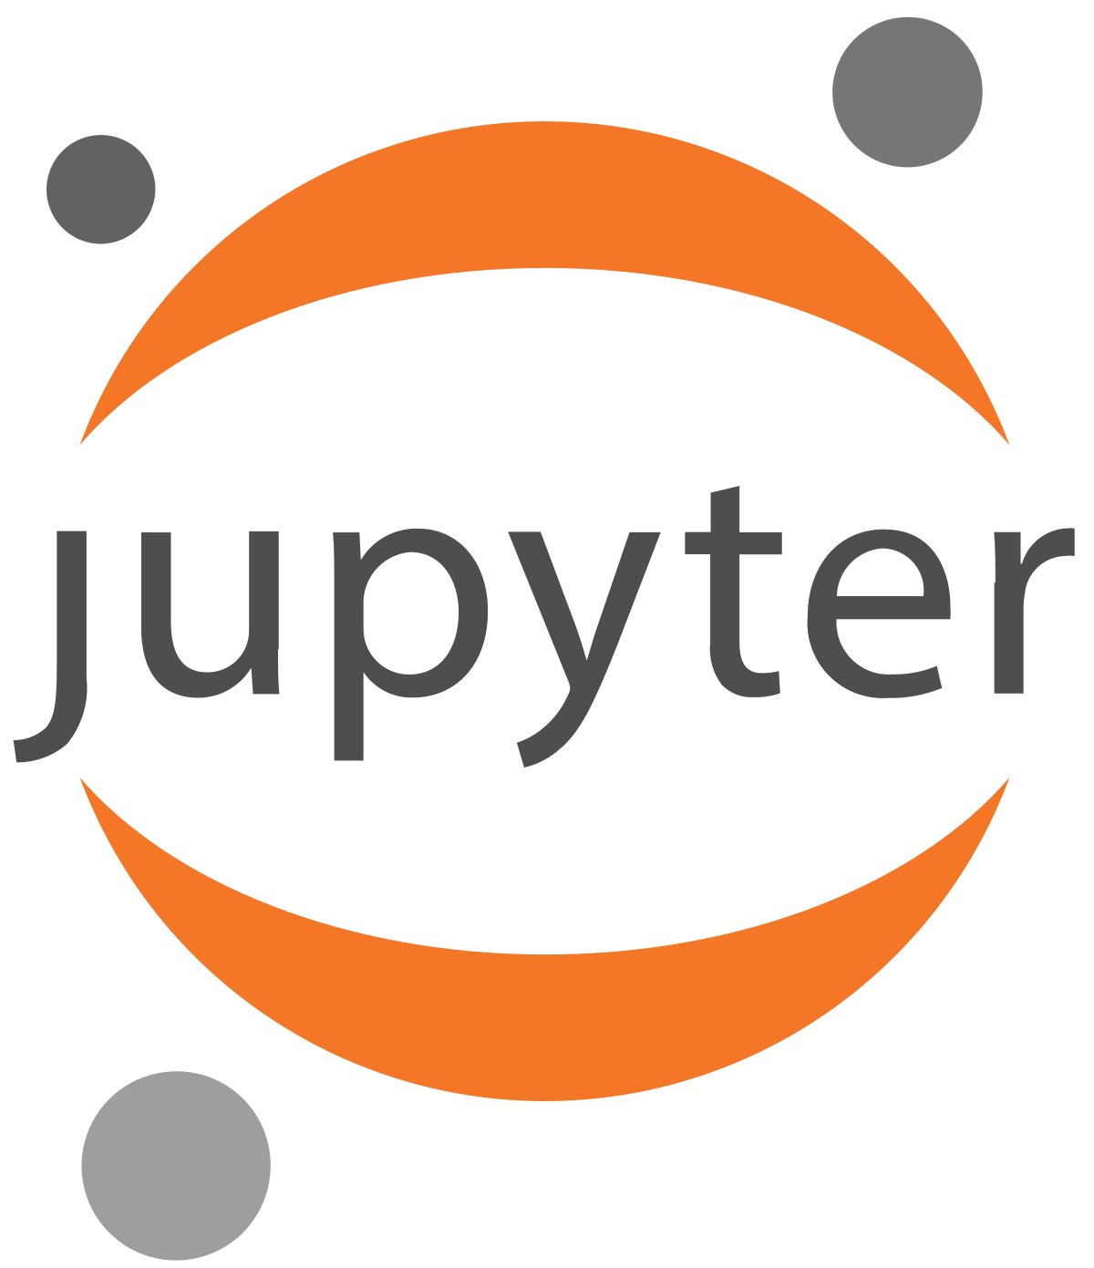

Installing Python and setting up the environment
There are several development environments you can use for Python.
Visual Studio Code
MU
Pycharm
RStudio
Spyder
Google Colab
For the purpose of this course we will use the jupyter notebooks

Slide 13
Jupyter notebook
An open-source web application that allows users to create and share documents containing live code, equations, visualizations, and narrative text.
It is a popular tool for working with data science tools and technologies, such as Python, R, and Julia.
One of the key benefits of Jupyter Notebook is its interactivity. Users can modify the code and see the results immediately, allowing for iterative development and experimentation.
Jupyter Notebook allows for easy sharing and collaboration, as notebooks can be saved and shared as files, or uploaded to services such as GitHub or Google Colab.
Jupyter Notebook supports a wide range of data science tools and technologies, including popular libraries such as NumPy, Pandas, and Matplotlib for data manipulation and visualization, as well as machine learning frameworks such as TensorFlow and PyTorch.

Slide 14
Google Colab layout

Slide 15
The print statement
The print statement is a built-function used to display output on the console. It can be used to print a message (i.e., text), a value (i.e., number) or a combination of both.
print("Hello World")
The command above displays the text "Hello, World!" in the console.
print(25)
The command above displays the value 25 in the console

Slide 16
Data types

Slide 17
Arithmetic operators

Slide 18
Arithmetic expressions

Slide 19
Boolean expressions

Slide 20
Variables

Slide 21
The input command

Slide 22
Getting started with python
Click here

Slide 23
What is Data Science

Slide 24
What is Data Science?
Data science is a field of study that involves using data to gain insights and knowledge about a particular topic or problem. It combines elements of statistics, computer science, and domain expertise to analyze and interpret data.
The main goal of data science is to extract useful information from large datasets and use this information to solve problems or make decisions. This can involve creating predictive models, identifying patterns and trends, or performing data visualization to better understand complex data.
In essence, data science helps us make sense of the vast amount of data that we have access to in today's world, and helps us make better decisions based on this information.

Slide 25
Aspects of data science
Data Collection
Data Cleaning
Data Analysis
Data Visualization
Machine Learning
Communication
Notes:
Data Collection: This involves gathering data from various sources such as databases, APIs, surveys, sensors, social media, and other relevant sources.
Data Cleaning: This is the process of ensuring that the data is accurate, complete, and ready for analysis. It involves tasks such as removing duplicates, dealing with missing values, and correcting errors.
Data Analysis: This is where data science really comes into play. The data is analyzed using statistical techniques, machine learning algorithms, and data visualization tools to gain insights and extract meaning from the data.
Data Visualization: This aspect of data science involves creating charts, graphs, and other visual representations of the data to make it easier to understand and communicate the findings to others.
Machine Learning: This is a subfield of data science that involves building models that can learn from data and make predictions or decisions based on that learning.
Communication: Finally, data science requires effective communication skills to be able to present the findings to stakeholders and decision-makers in a way that is easy to understand and actionable.

Slide 26

Importance of Data science in the medical field

Slide 27

Data science and medical industry
Data science is becoming increasingly important in the medical industry due to the large amounts of data generated by electronic health records, medical devices, and clinical trials. Here are some key reasons why data science is important in the medical industry:
Predictive modelling: Data science allows medical professionals to use machine learning algorithms to predict disease progression, identify at-risk patients, and personalize treatments based on individual patient characteristics.
Precision medicine: Data science enables researchers to analyze genomic data and develop targeted therapies for specific genetic mutations. This approach to medicine can lead to more effective treatments with fewer side effects.
Clinical trials: Data science can help researchers design and conduct more efficient and effective clinical trials, leading to faster drug development and approval.
Patient outcomes: By analyzing large datasets, data science can help medical professionals identify trends in patient outcomes, leading to improved treatment plans and better overall care.
Public health: Data science can be used to analyze population-level health data, identify disease prevalence trends, and develop disease prevention and control strategies.

Slide 28
Examples of Data Science in the medical field
Data Analysis:
Analyzing electronic health records (EHR) to identify disease patterns, trends and risk factors
Analyzing clinical trial data to assess the effectiveness of new treatments
Analyzing epidemiological data to track the spread of diseases
Image Analysis:
Analyzing medical images such as X-rays, MRIs, and CT scans to detect abnormalities
Identifying tumours, lesions, and other abnormalities in medical images using machine learning algorithms
Tracking the progression of diseases by analyzing images over time
Machine Learning:
Developing predictive models to identify patients at risk of developing certain conditions such as diabetes, cardiovascular disease, or cancer
Developing algorithms to assist with clinical decision-making, such as identifying the best treatment options for patients based on their medical history and symptoms
Developing diagnostic tools using machine learning algorithms that can automatically identify certain diseases from medical images or patient data
Natural Language Processing (NLP):
Analyzing unstructured clinical notes and medical records to extract useful information such as diagnoses, treatments, and medication dosages
Developing chatbots or virtual assistants that can answer patient questions or provide medical advice
Develop algorithms that can classify medical texts, such as medical publications or clinical guidelines, into different categories or topics.

Slide 29
Diabetic Retinopathy case-study
Gulshan and Peng et al 2016 JAMA

